Slide 1

ElderEase
EASE A DAY, BRIGHTEN A LIFE
Dina Kakiashvili
Natalie Nanikashvili
Deployment to our project: https://incomparable-taiyaki-956d9f.netlify.app/

Slide 2
The problem
Older individuals often face numerous challenges that significantly affect their daily routines.
The challenges can be in many aspects, such as:
Physical - Technical Assistance: Household chores, Moving assistance, Furniture assembly, Delivery services, Personal assistance
Social
Medical
Technology
emergency situation
There is a desperate need for a solution that fits those challenges.
What seems simple to us can be a complex task for them

Slide 3
What is elderease?
An innovative solution in the form of an application.
Aims to bridge the gap between older individuals and compassionate volunteers.
Aims to enhance the overall well-being of older individuals
Aims for a better future both for elders and young people

Slide 4
MOTIVATION
Improve Quality of Life
Build Relationships (Social)
Increase Accessibility to Support
Provide Reliable Help
Facilitate Quick Response
Reduce Loneliness

Slide 5

requirements
Easy to use
Easy connection with the volunteers
Volunteers rating
Opening a new task(elders)
Accepting tasks(volunteers)
Closing finished tasks(volunteers)
Notifications about activity

Slide 6
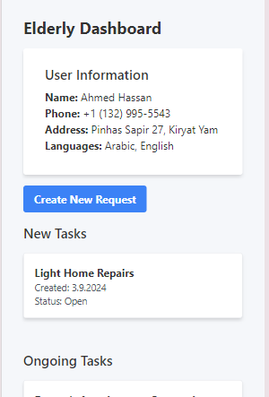
The solution - elderease Elder’s interface
Simple and intuitive profile creation
Specify daily needs, preferences, and specific assistance requirements.
Submit requests for tasks like shopping, transportation, or companionship
Access communication tools including in-app chat and phone contact with volunteers.
Track progress of ongoing tasks and view history of completed tasks.
Rate volunteers after each task to ensure trust and accountability.

Slide 7
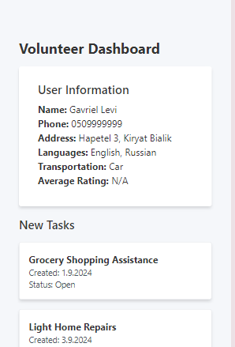
The solution - elderease volunteer’s interface
Create profiles highlighting availability, skills, and support areas.
Communicate with seniors via in-app chat or phone for smooth coordination.
Receive ratings and feedback from seniors after task completion to build reputation
Receive real-time notifications about new tasks and updates on accepted tasks.
Browse task requests from seniors and choose tasks based on schedule and skills.

Slide 8



The solution - elderease
Backend Frontend DB

Slide 9
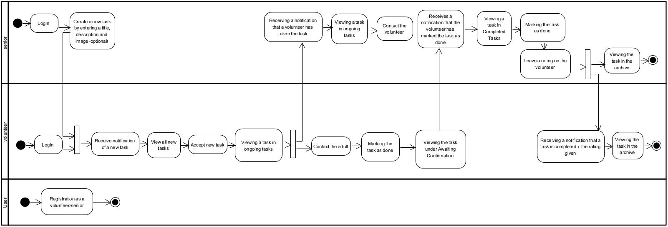
Activity diagram

Slide 10
key performance indicators
The interface is user friendly for both elders and volunteers
The interface matches the technological knowledge of most elders
The elders are able to get the help that they need
High percentage of tasks are done by volunteers
Positive feedback from both seniors and volunteers.
Average time taken for volunteers to accept tasks after they are posted.

Slide 11
challenges
Technical Challenges:
Developing the application using technologies we have never used before
Database Management
Deployment Process
Design Challenges (UX/UI):
Simplicity for Elderly Users
Creating an Accessible Application
Operational Challenges
Time Management
Managing User Feedback

Slide 12
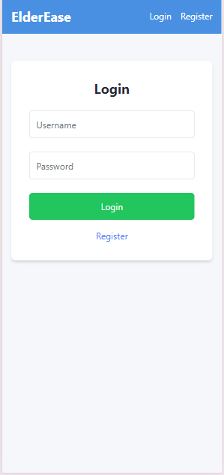
Elderease FLOW- elder’s side
A very elegant and not too detailed screen.
The elder/volunteer will login to his account using his username and password
Login is needed only once unless the elder clicks Log out
Registration for the application is done by clicking "register"

Slide 13
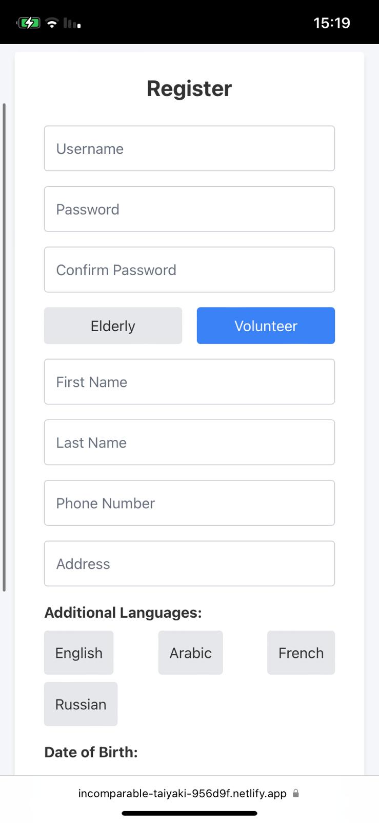
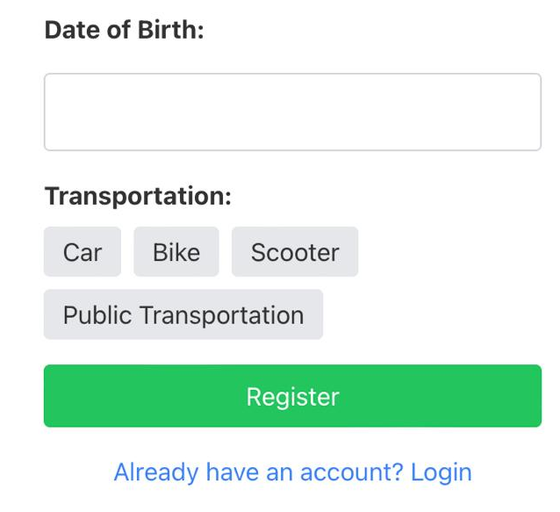
Elderease FLOW- Registration Screen
Both volunteers and elderly users must fill in the fields to complete their registration.

Slide 14
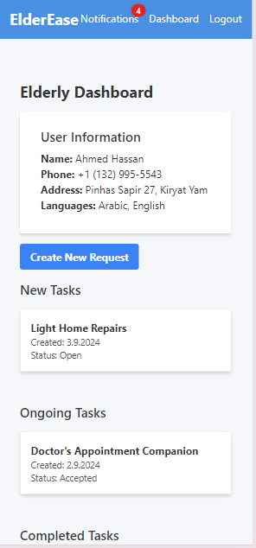
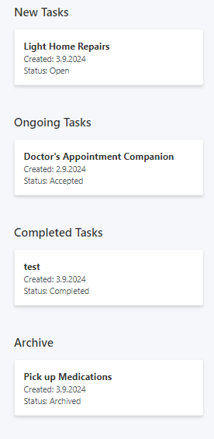
Elderease FLOW- elder’s side
The main screen for the elders.
Elders can:
Open new requests
Watch task that he opened and still unsigned to volunteer
Watch tasks that are already assigned to volunteer
Watch tasks that are completed by the volunteers and waiting to his confirmation
Watch tasks that finished from the archive
Get notifications about activity
Communicate with the volunteer through the app
Rate the volunteer

Slide 15
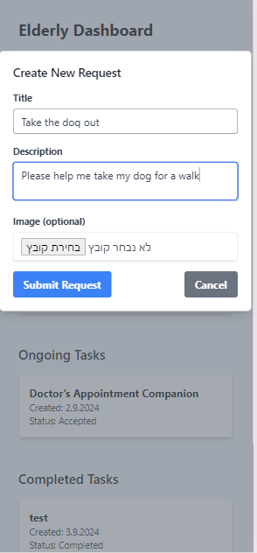
Elderease FLOW- elder’s side
The elder can open a new request, fill in the title and the content of the request
The elder can upload files such as prescriptions for the volunteers
The elder will click “Submit Request” to submit the help request.

Slide 16
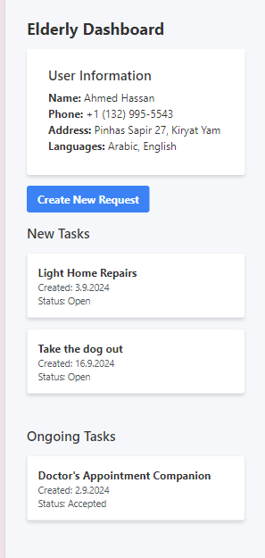
Elderease FLOW- elder’s side
When finished, the elder will be able to see his help request among the list of new tasks

Slide 17
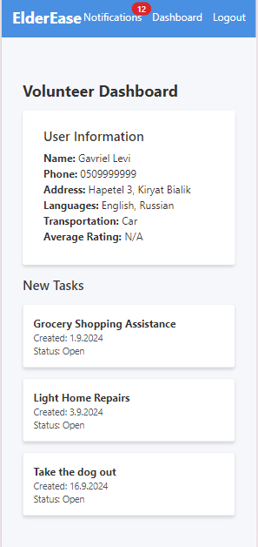
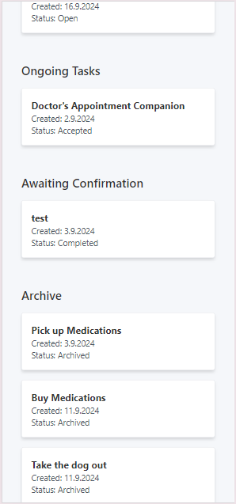
Elderease FLOW- Volunteer’s side
The main screen for the volunteers.
Volunteers can:
Watch unassigned tasks
Accept tasks
Watch tasks that he accepted under Ongoing tasks
Watch tasks that are completed by him and are waiting for adult confirmation
Watch tasks that finished from the archive
Get notifications about activity
Communicate with the elder through the app
Watch their rating

Slide 18
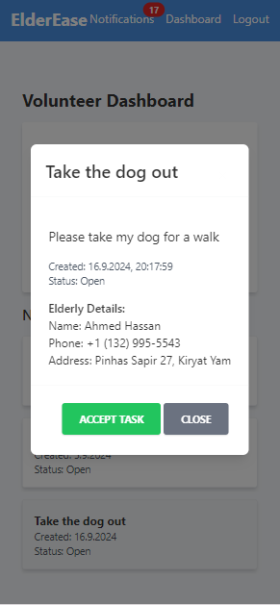
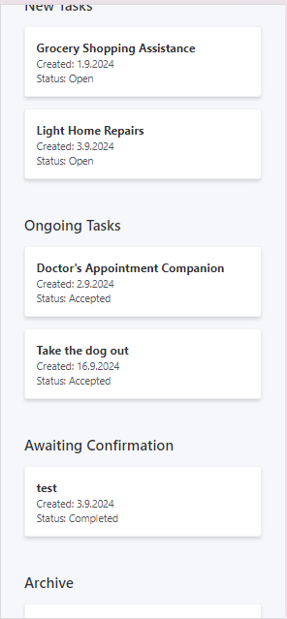
Elderease FLOW- Volunteer’s side
All the details of the help request will be shown to the volunteer.
The volunteer can accept the task
It will then appear in his ongoing tasks

Slide 19
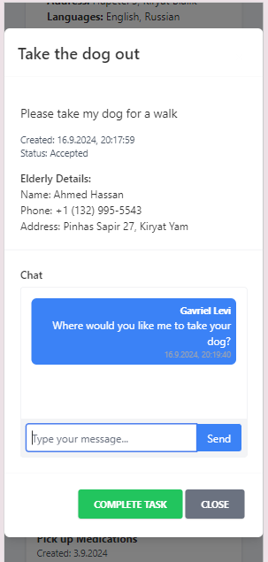
Elderease FLOW- CHAT COMMUNICATION
Both volunteer and elder will be able from now on to send each other messages on chat.
Every new massage will create a notification for the other side.

Slide 20
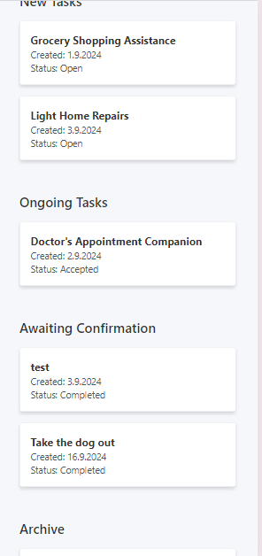
Elderease FLOW- Volunteer finish task
When the volunteer is done helping the elder, he will click “complete task”
The task will now be shown under awaiting confirmation.

Slide 21
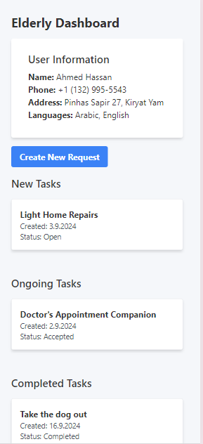
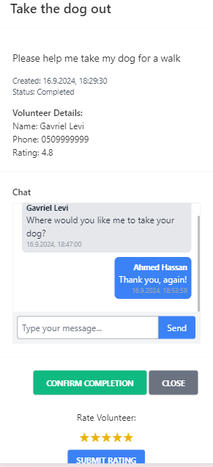
Elderease FLOW- Elder finish task
The elder will now need to confirm that the volunteer is done.
In this point the elder will leave a feedback about the volunteer.

Slide 22
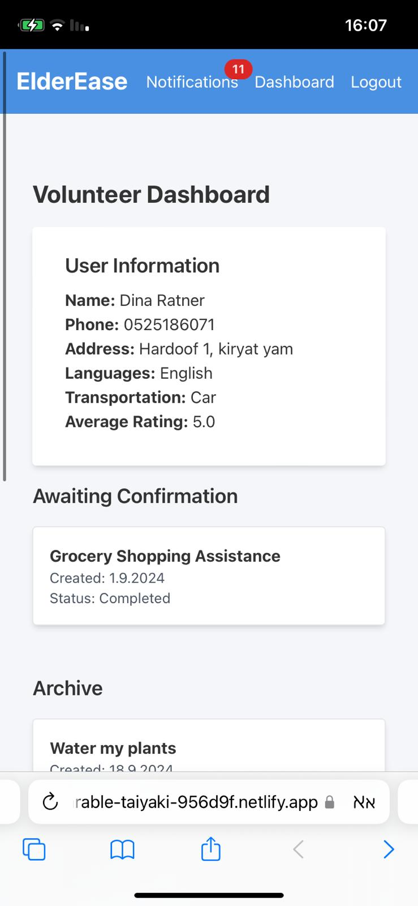
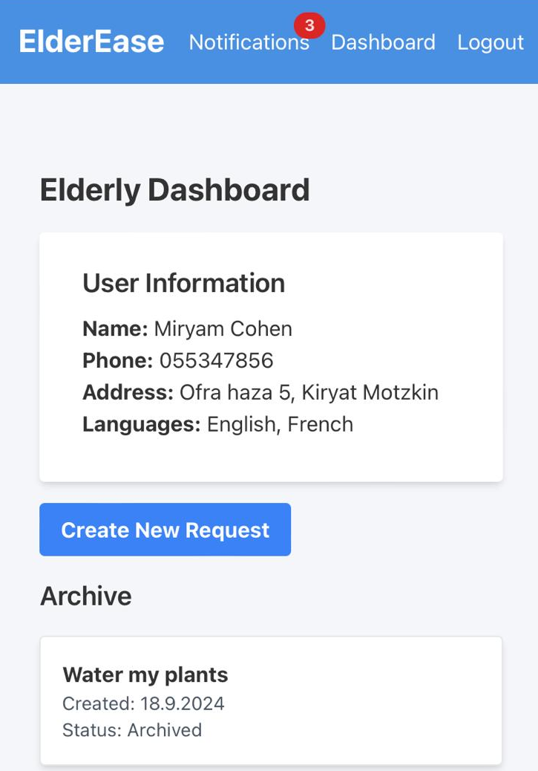
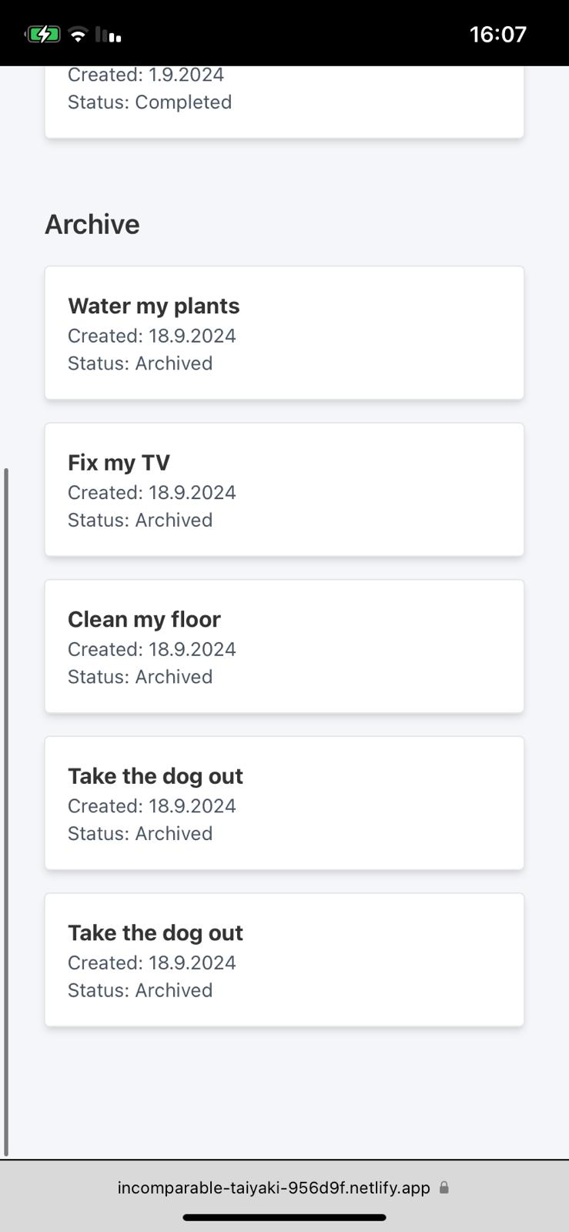
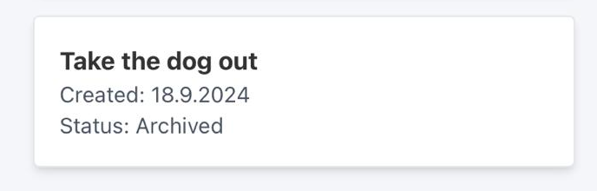
Elderease FLOW-Task moves under ARCHIVE
Once the elderly user confirms that the task is completed, it moves to the archive on both the volunteer's side and the elderly user's side.

Slide 23
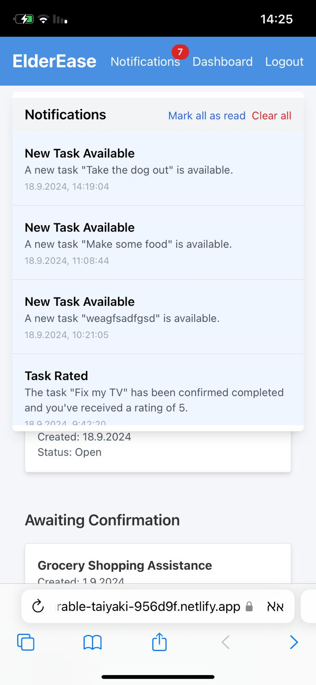
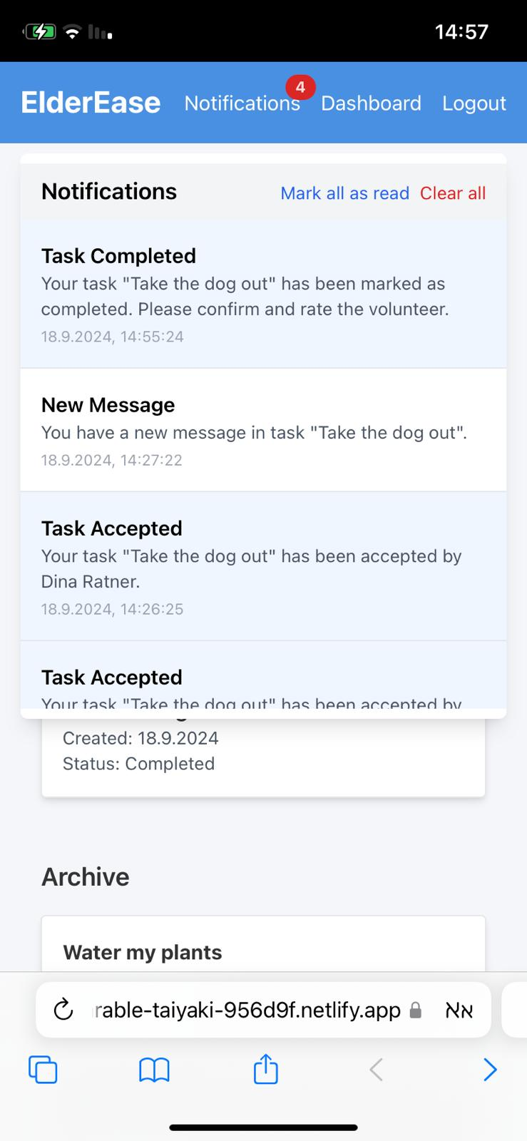
Elderease FLOW- Notifications
Both elder and volunteer are able to get notifications about the activity In the application

Slide 24
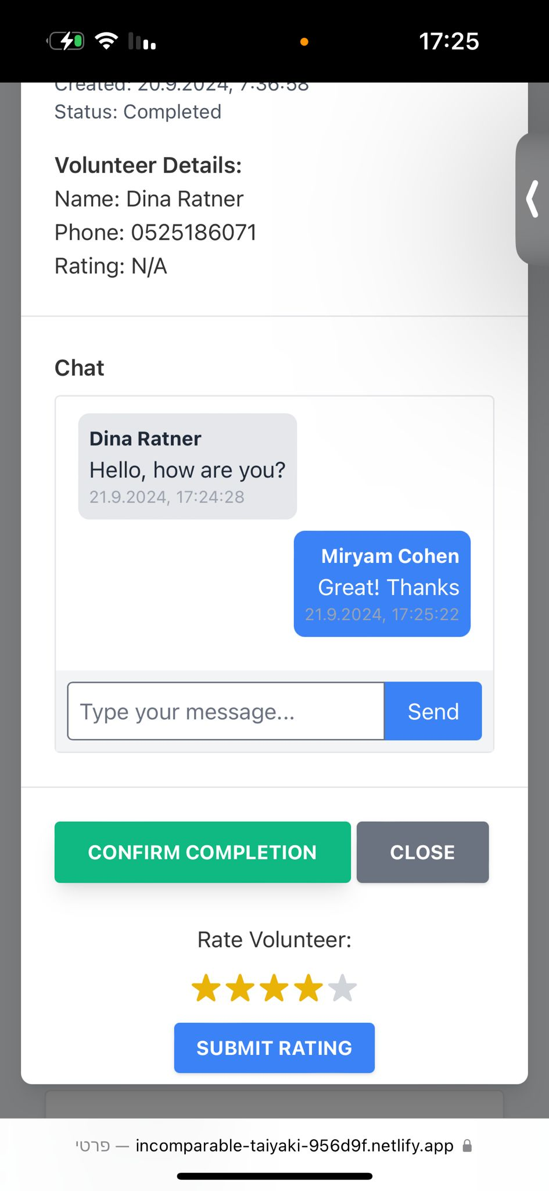
Elderease FLOW- rating
After the task is done by the volunteer, the elder need to confirm that the task is finished and rate the volunteer

Slide 25
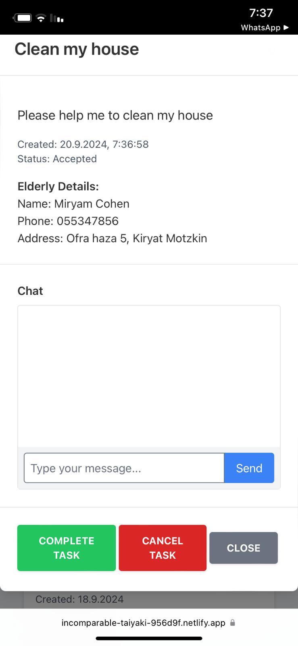
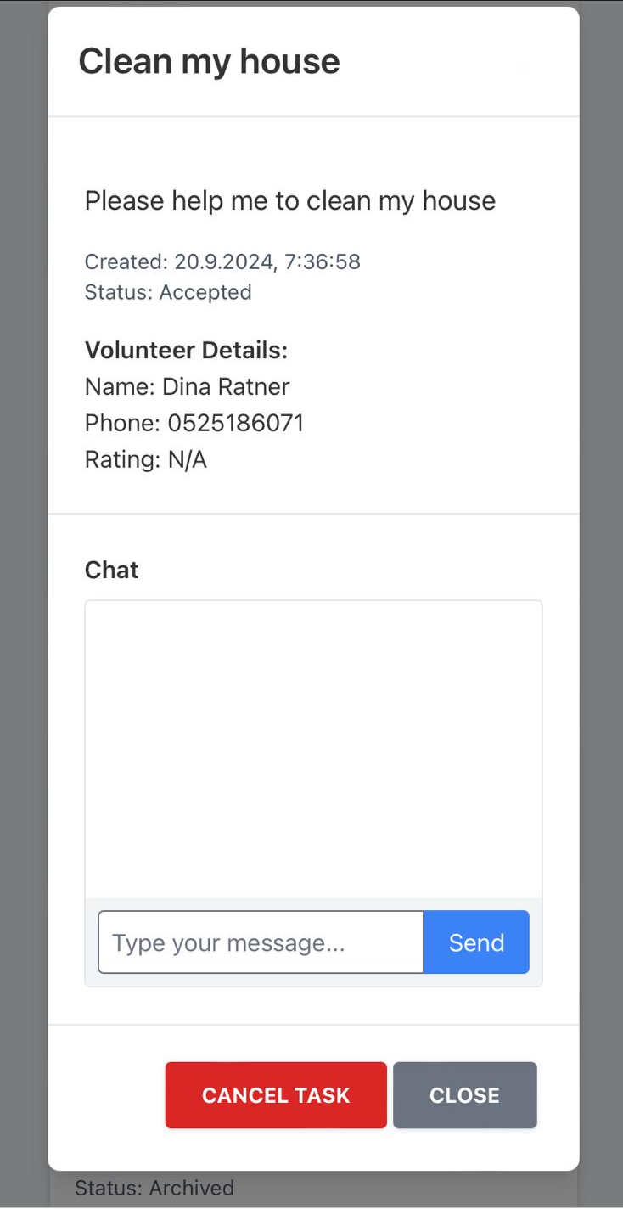
Elderease FLOW- CANCEL TASK
Both volunteer and elder can cancel tasks through the application

Slide 26
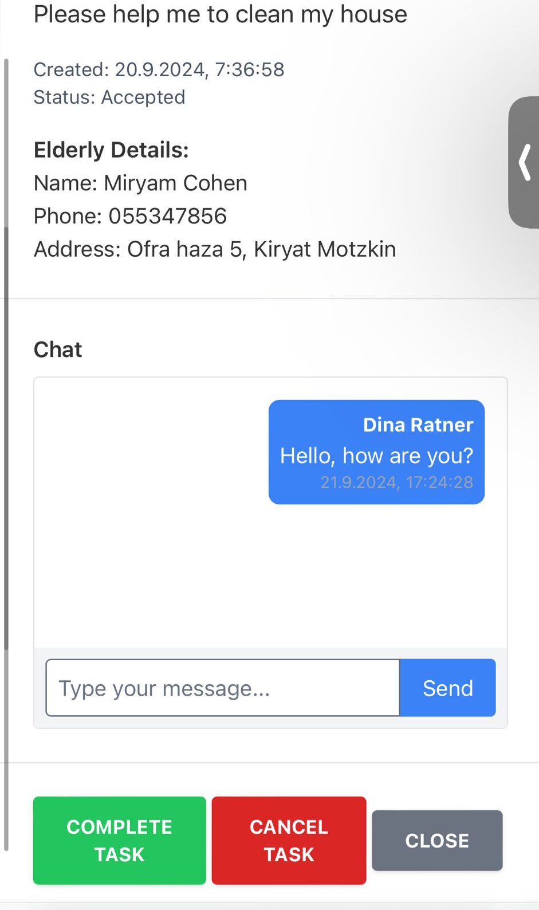
Elderease FLOW- CHAT
The volunteer and the elder will be able to send messages to each other in the application

Slide 27
Thank you for listening!

